Slide 1

Working with RDS
Project Supervisor: Dr.V.Ulagamuthalvi
Name of the Student: CHENNA ANVESH KUMAR
Register Number: 40110255

Slide 2
Presentation Outline
Course Certificate
Introduction
Objectives
System Architecture / Ideation Map
Module Implementation
Application Snapshots
Results and Discussions
Conclusion & Future work
References

Slide 3
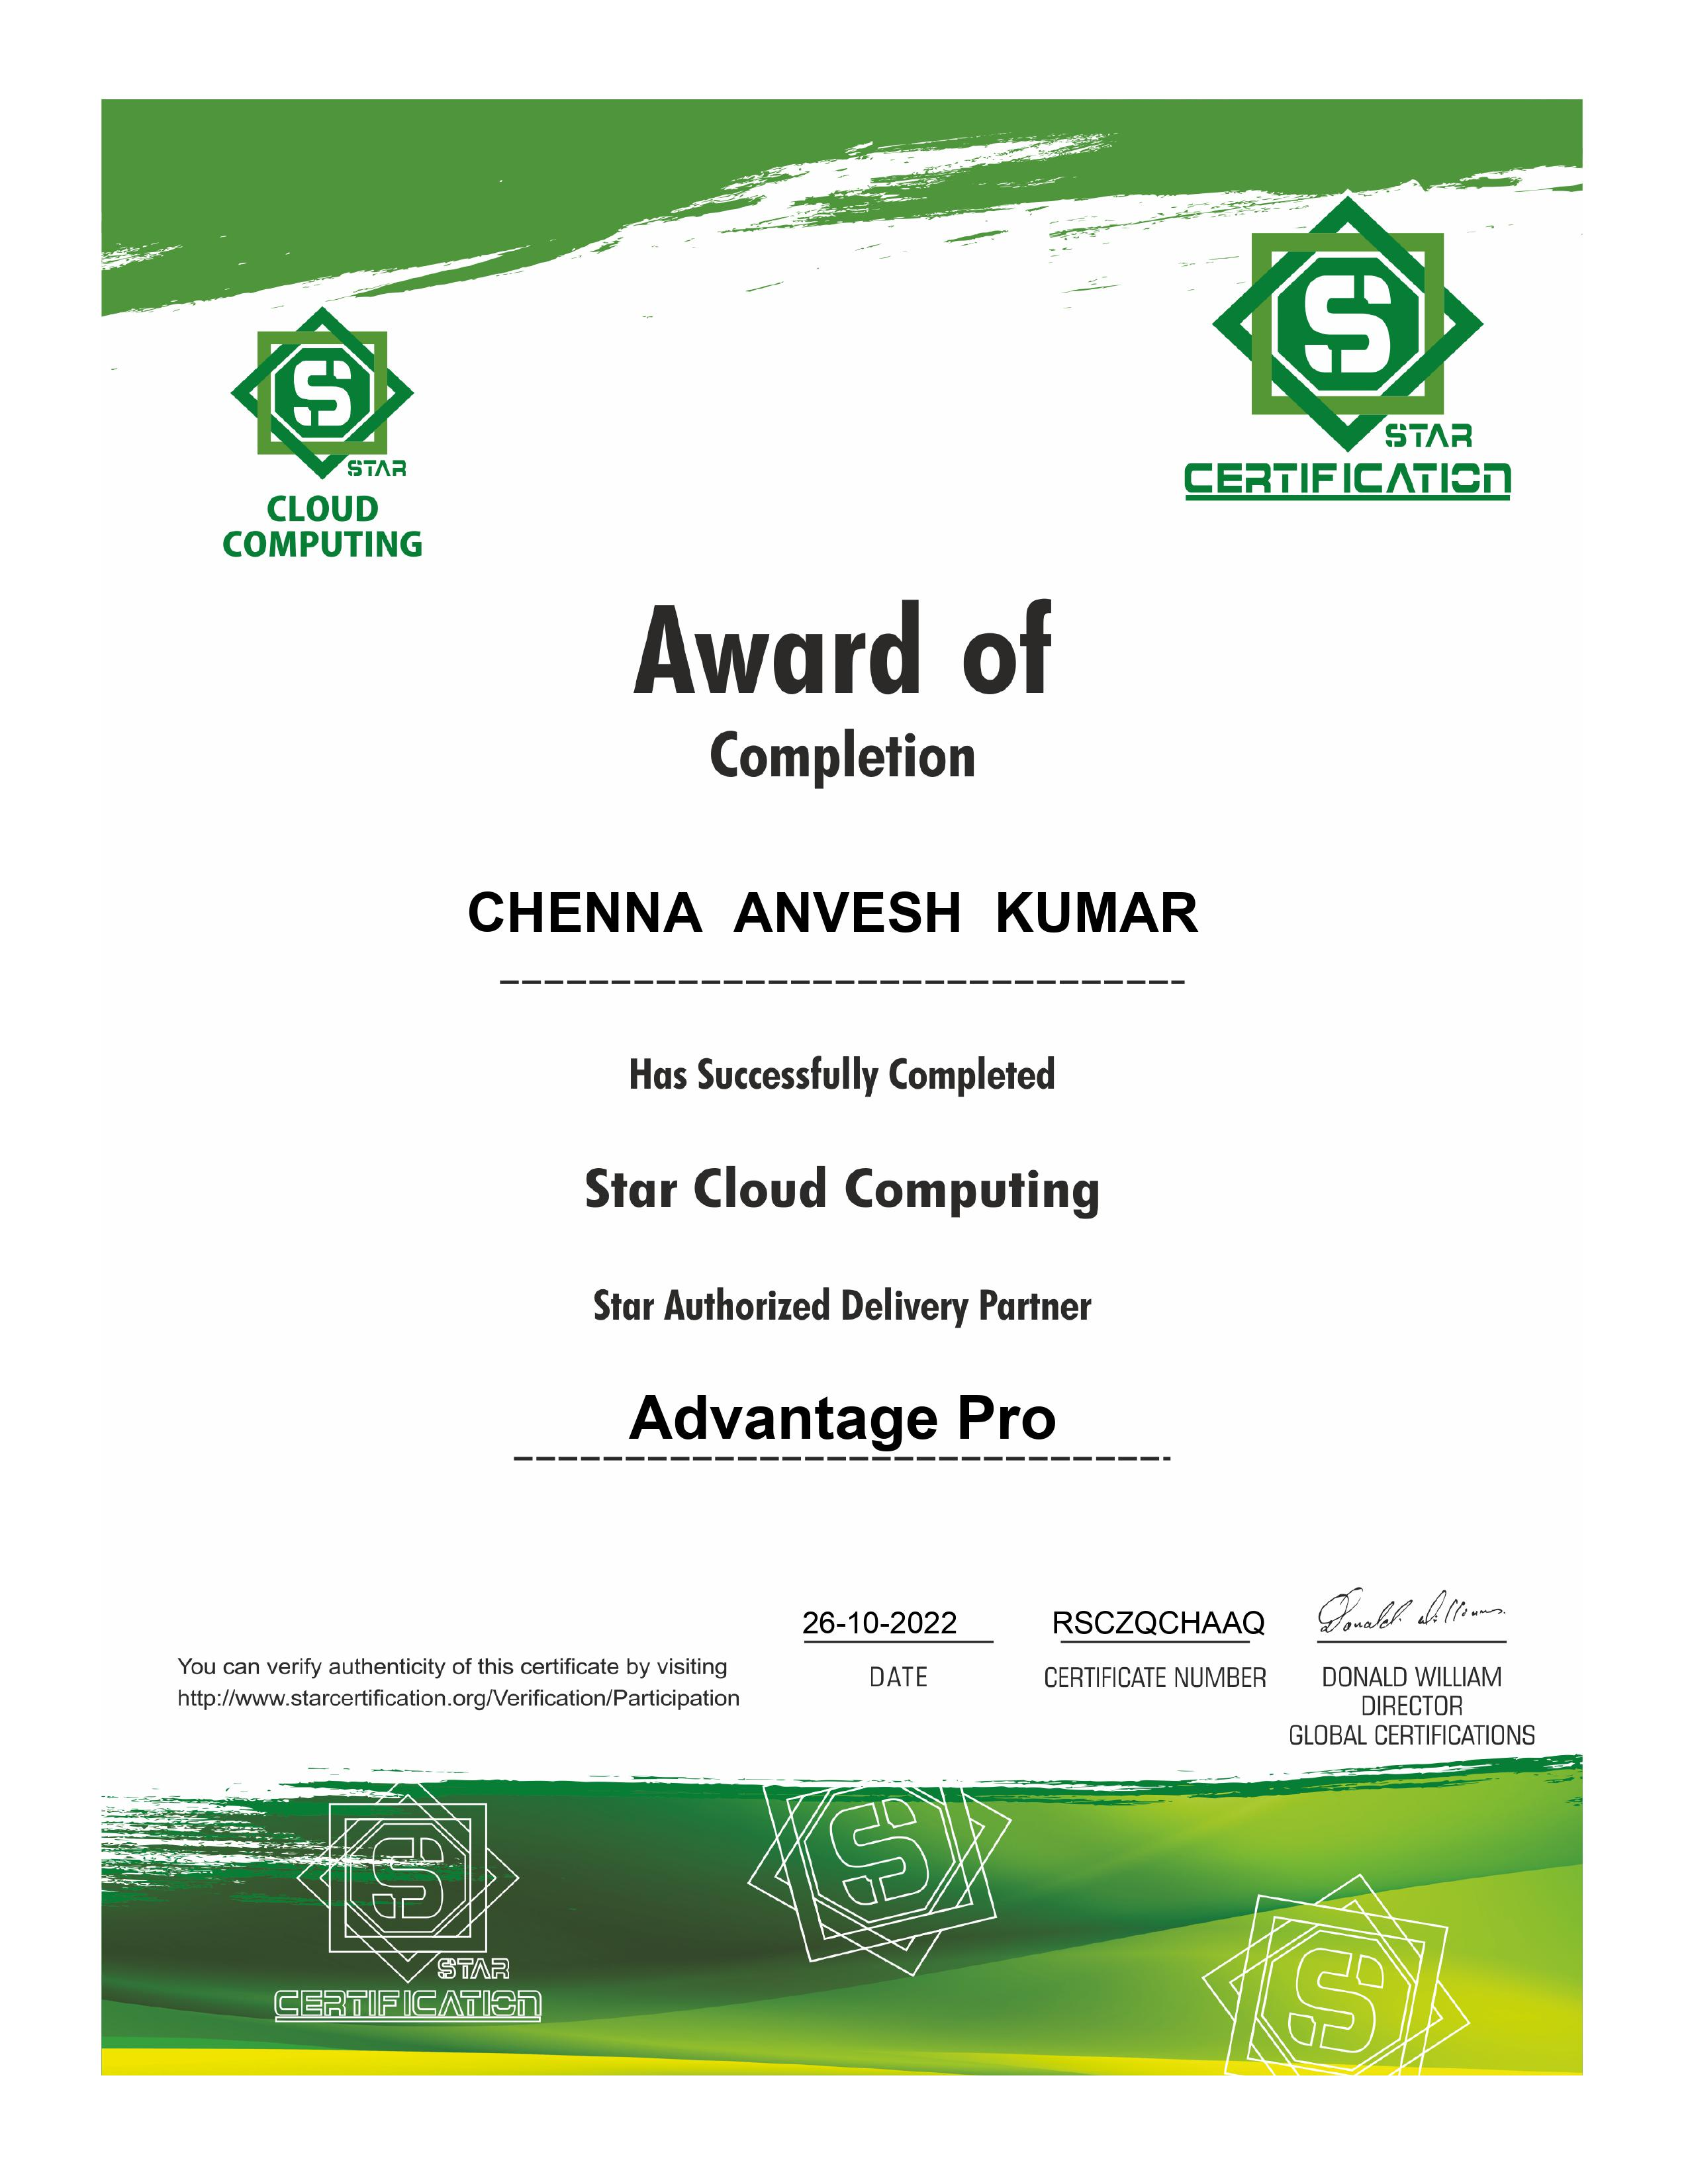
Course Certificate

Slide 4
Introduction
Work includes AWS cloud computing it is a on-demand delivery of IT resources over the Internet with pay-as-you-go pricing.
Instead of buying, owning, and maintaining physical data centers and servers, you can access technology services, such as computing power, storage, and databases, on an as-needed basis from a cloud provider like Amazon Web Services (AWS)

Slide 5
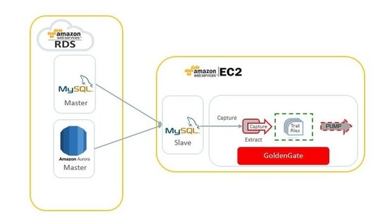
MYSQL database from AWS RDS to EC2

Slide 6
Objectives
Sign for an AWS account
Create an administrative user
Create IAM user access key
Determine requirements
Provide access to your DB C by creating a security groupinstance in your VP
Creating a MYSQL DB instance and connecting to database

Slide 7
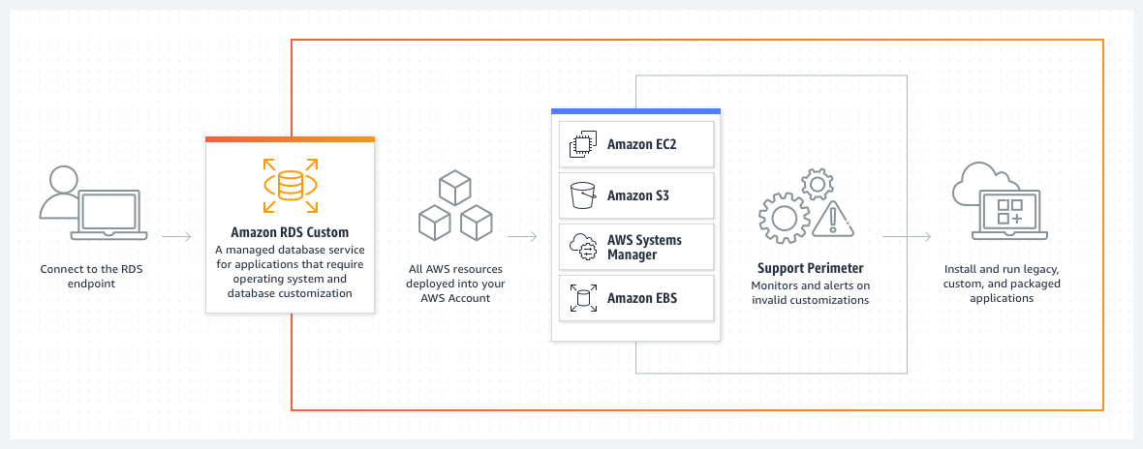
System Architecture/ Ideation Map
11 November 2021
Department of CSE

Slide 8
Project Implementation
1. Create a AWS account
Click on web browser and type amazon AWS
Click on create an AWS Account
Giving mail and account name and it verify mail through OTP
Enter account details for billing information
The consule home has been opened

Slide 9
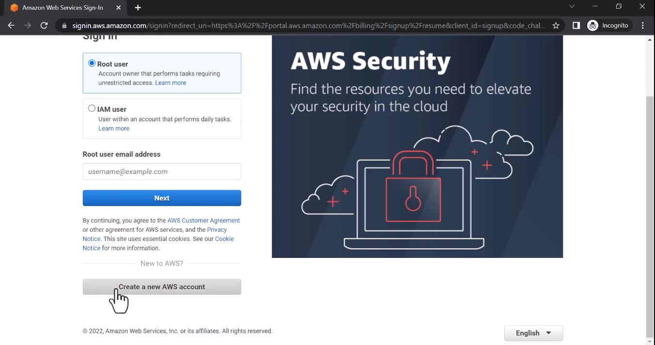
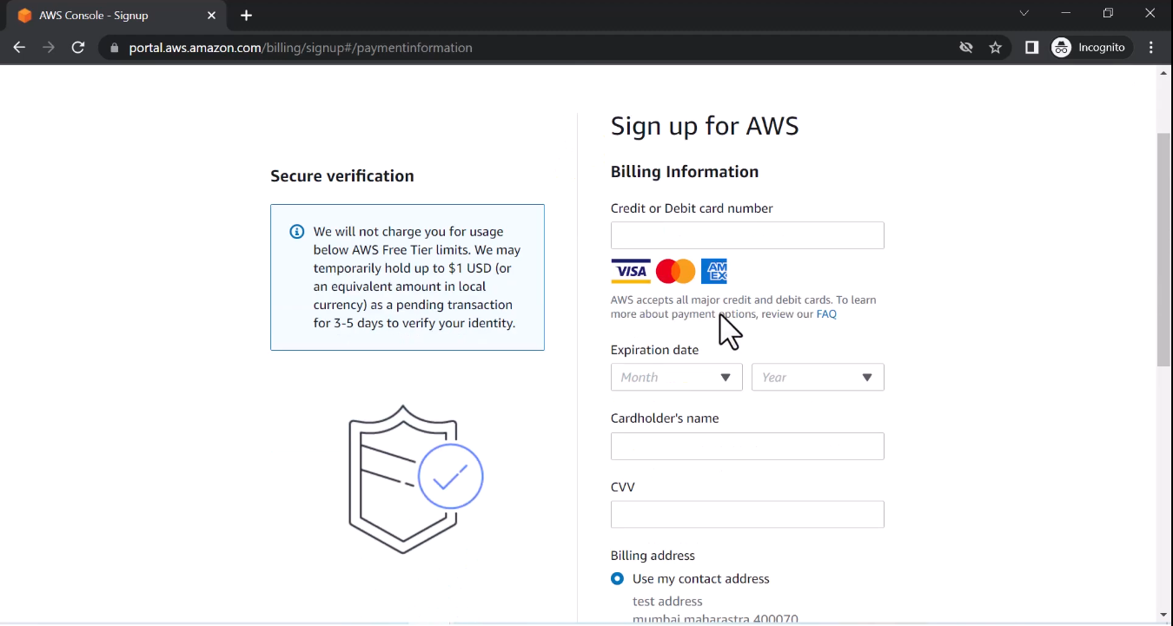
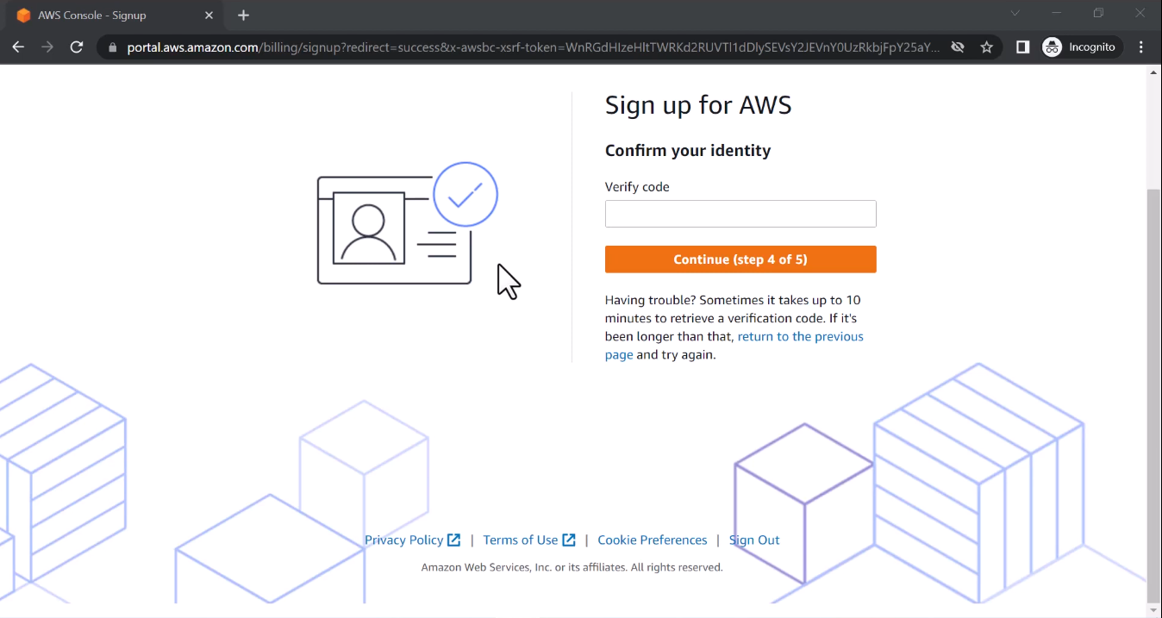
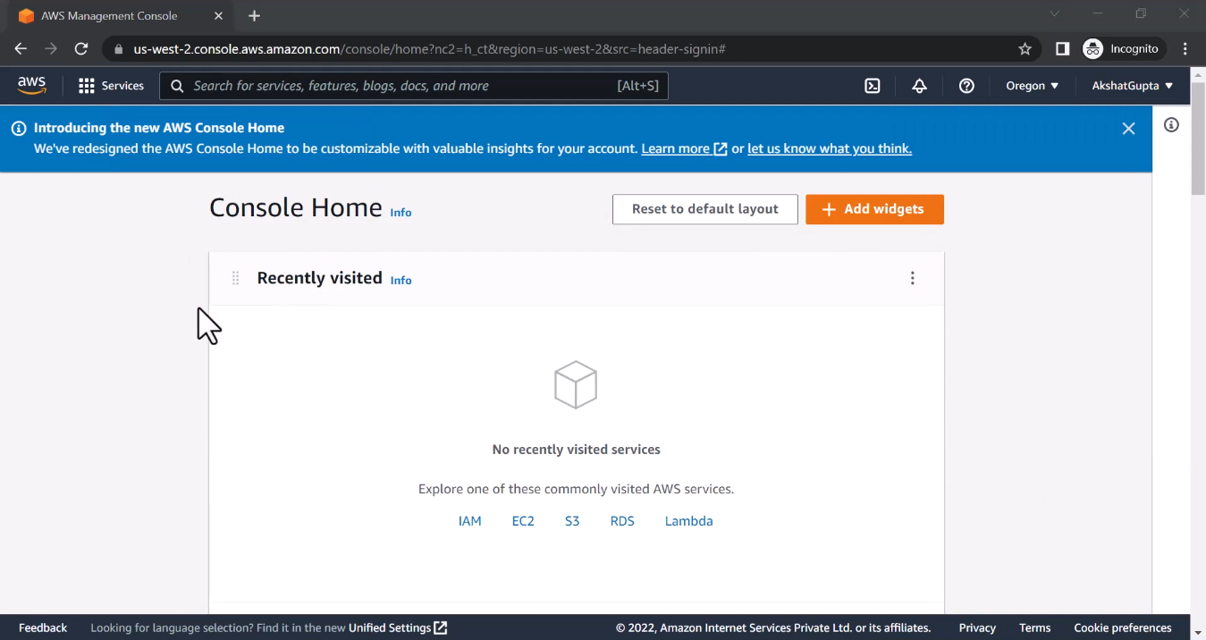

Slide 10
Project Implementation
2. Creating a MySQL Database with RDS
Go to the Amazon Home Page
In search bar type RDS and click on it
Click on create database and select MYSQL engine
Enter necessary details and click on create database

Slide 11
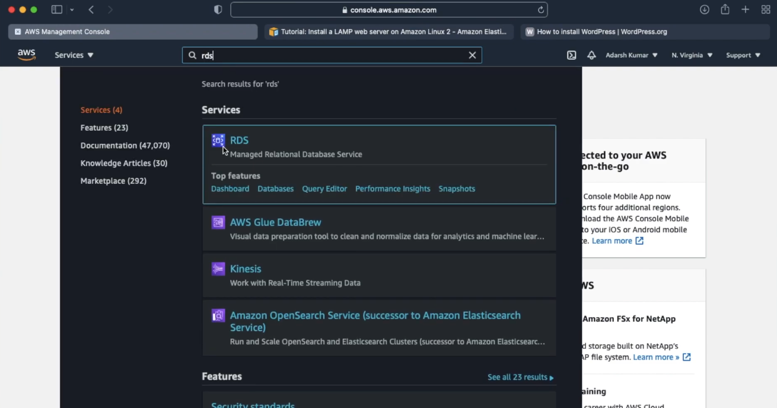
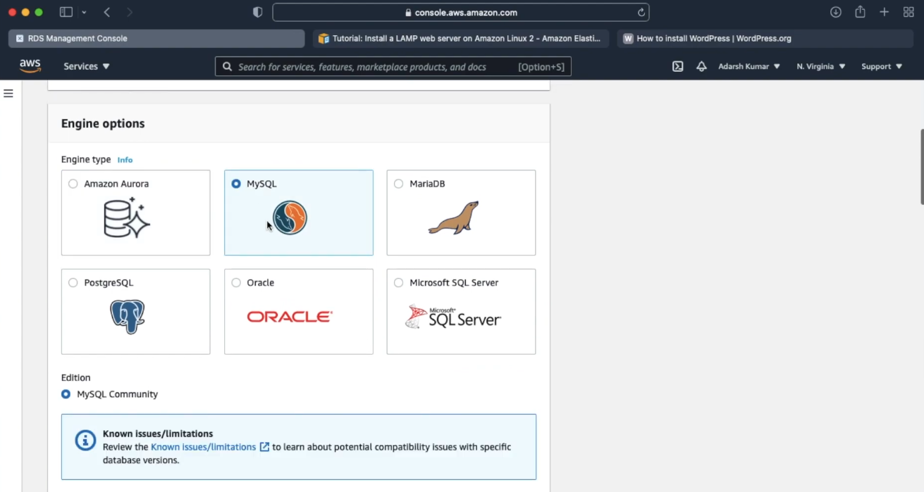
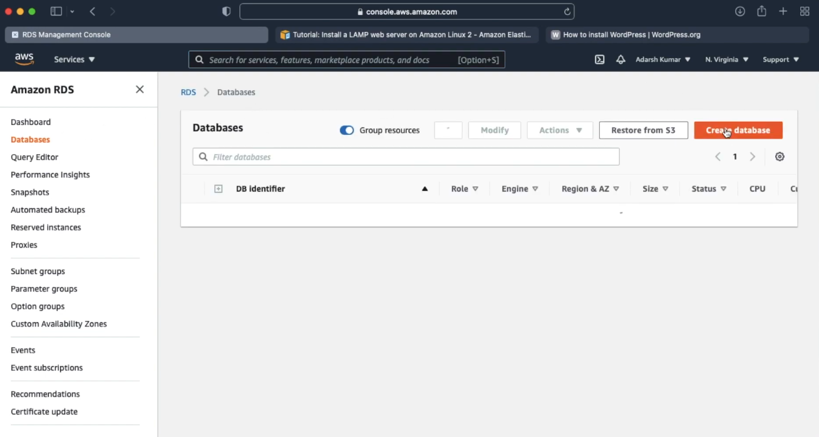
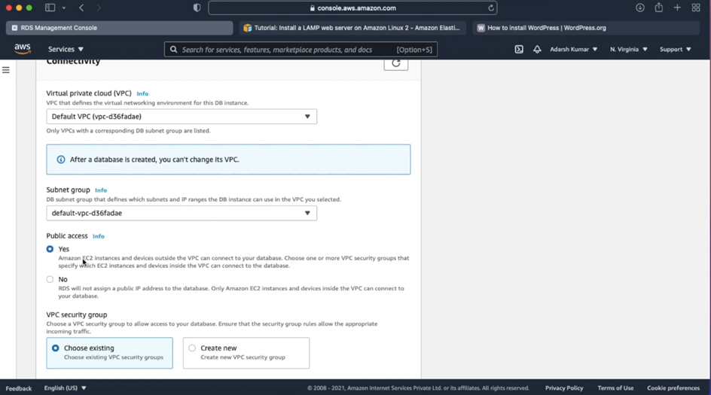

Slide 12
Project Implementation
3. Creating an EC2 Instance
Go to the Amazon Home Page
In search bar type EC2 and click on it
Click on launch instance button, choose AMI(amazon machine image)
Configure security details
Click on launch button, if instances is created then rename it as WordPress and click on connect button

Slide 13
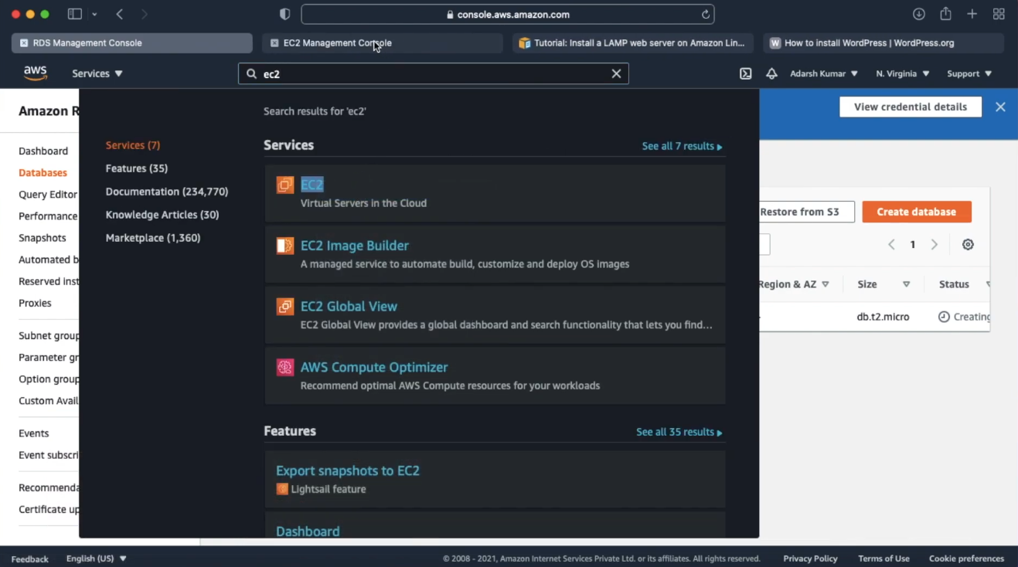
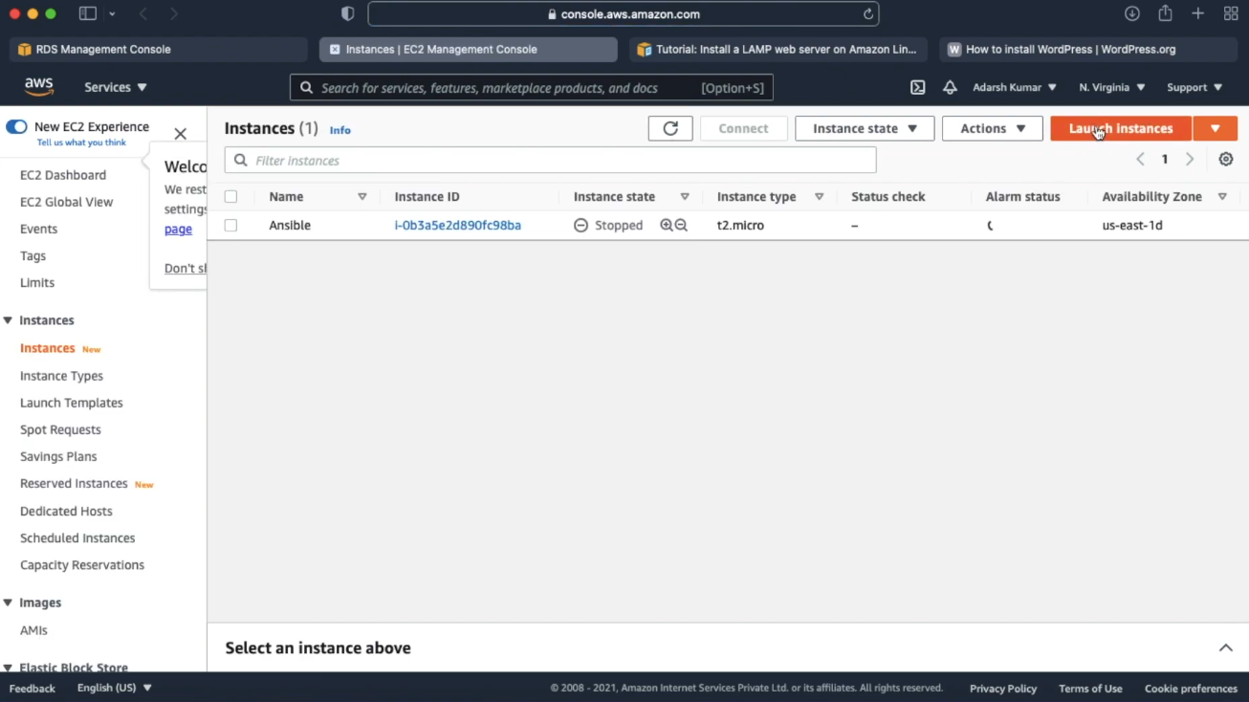
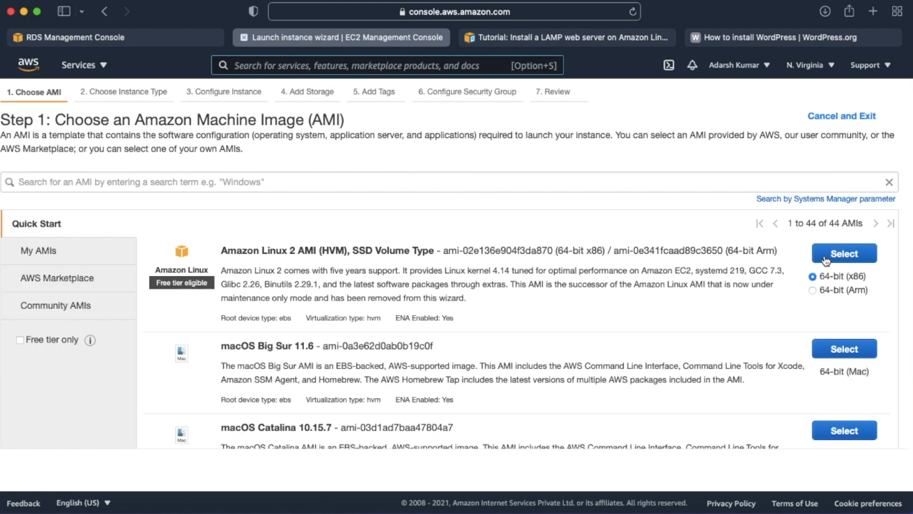
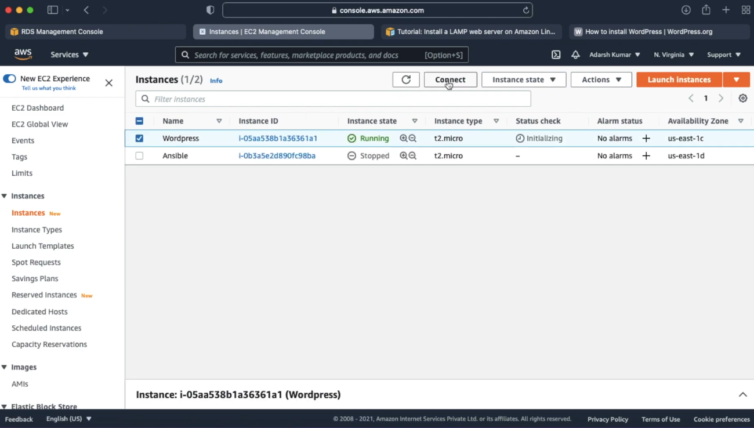

Slide 14
Project Implementation
4. Configuring WordPress on EC2
Copy the SSH(secure shell)command ,paste in terminal
Configure the land server ,the word press will run on it using the documentation of aws
For configure the land server we have update it ,install the required packages ,install httpd web servers ,enabling the httpd service ,give some required permissions and checking whether it is working or/not
Downlord the wordpress

Slide 15
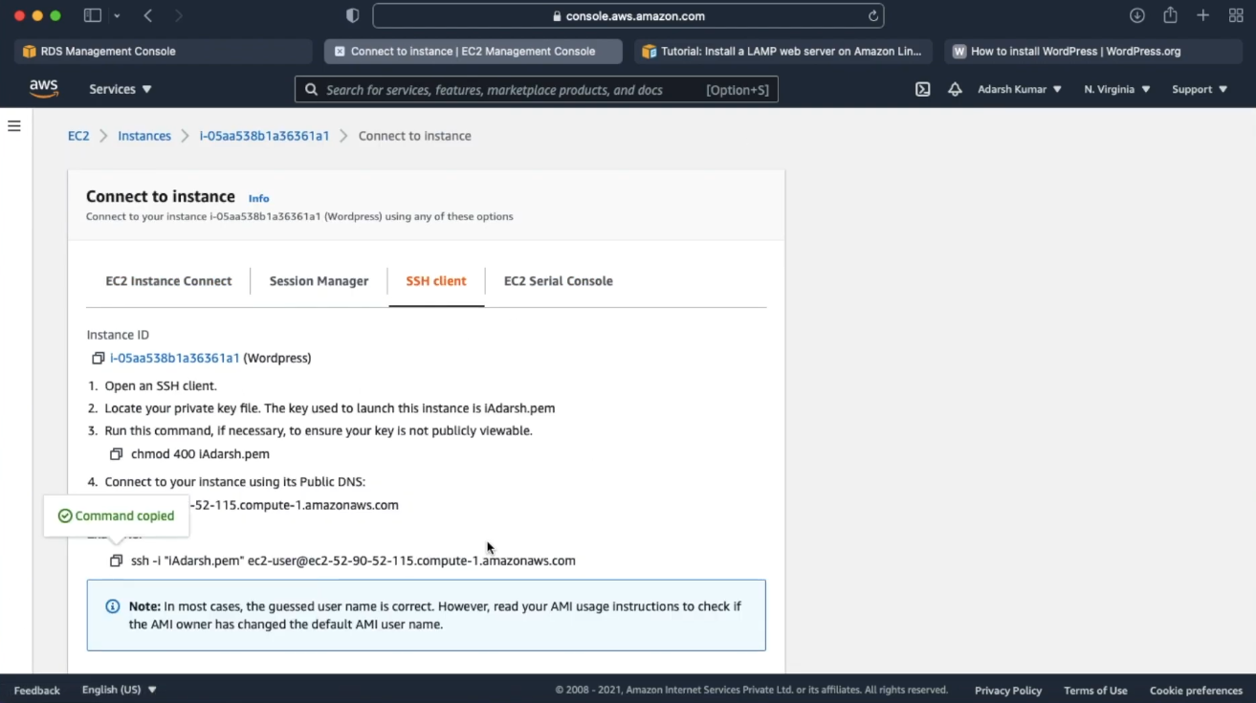
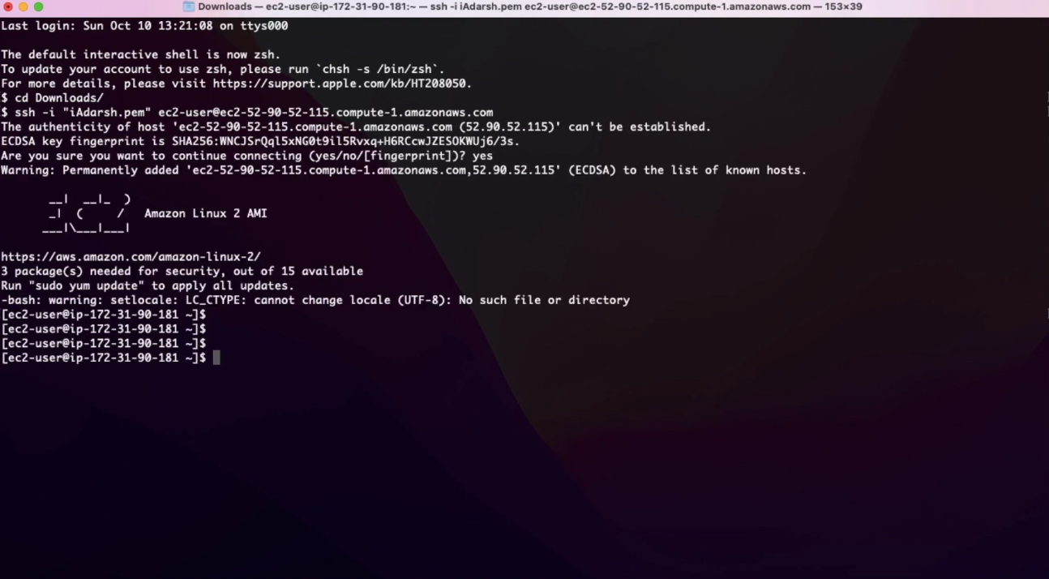
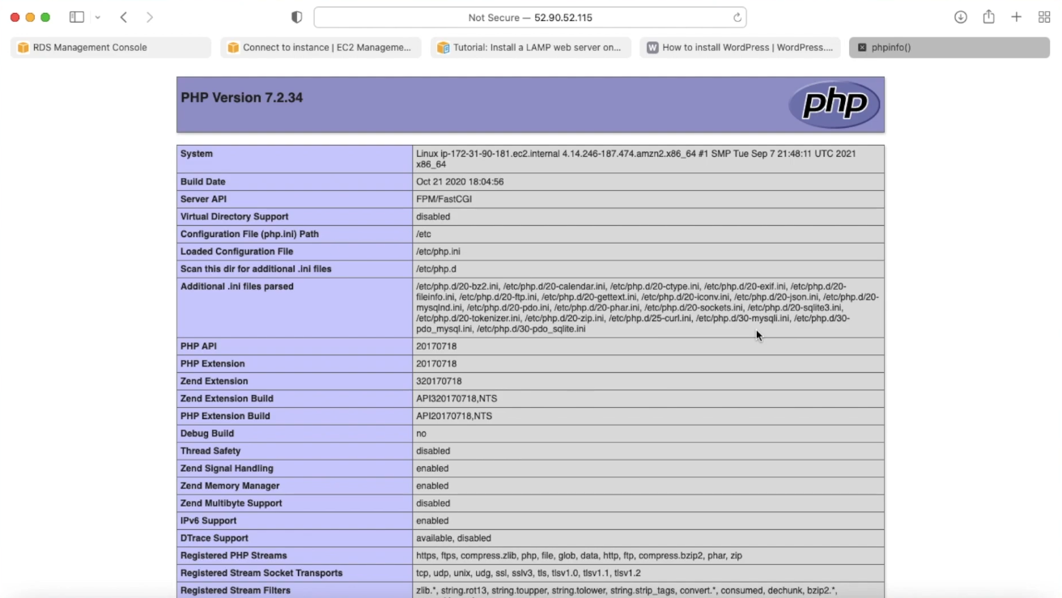
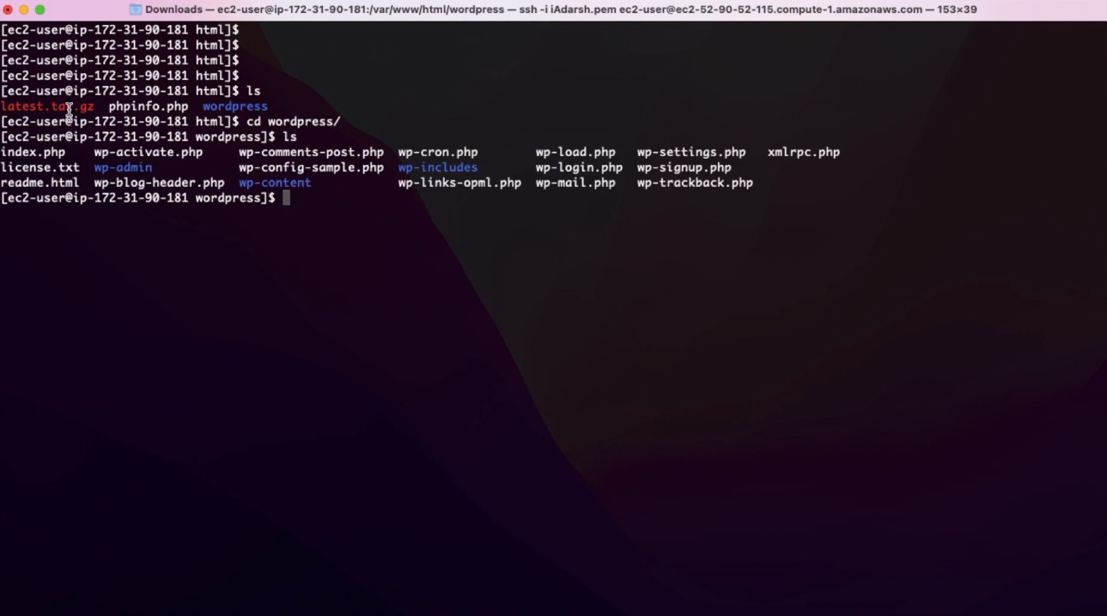

Slide 16
Project Implementation
5. Configuring Your RDS Database
In amazon RDS click on database copy the endpoint and paste it on command prompt ,give credentials
Create a database with name
Go to web browser after the ip name provide the path of the database instance
The wordpress is open then connect with rds by giving the details
We need to store the configuration and create a file
Run the install wordpress

Slide 17
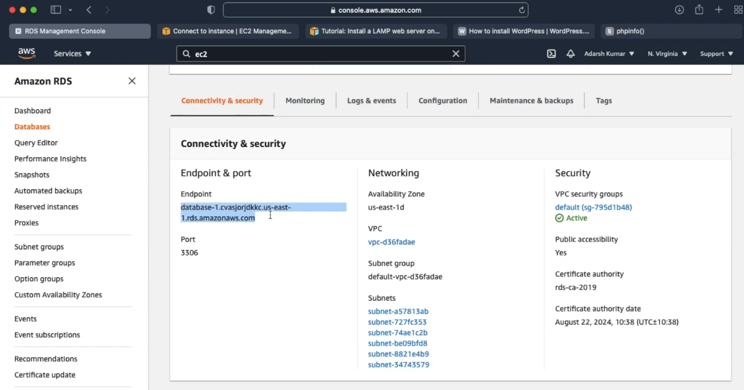
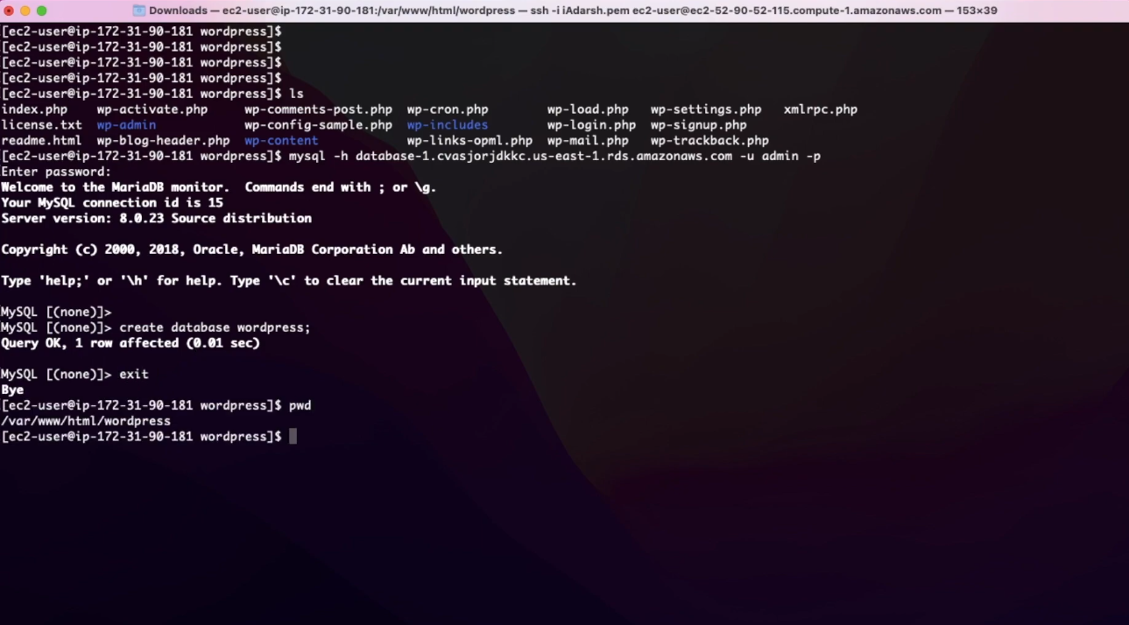
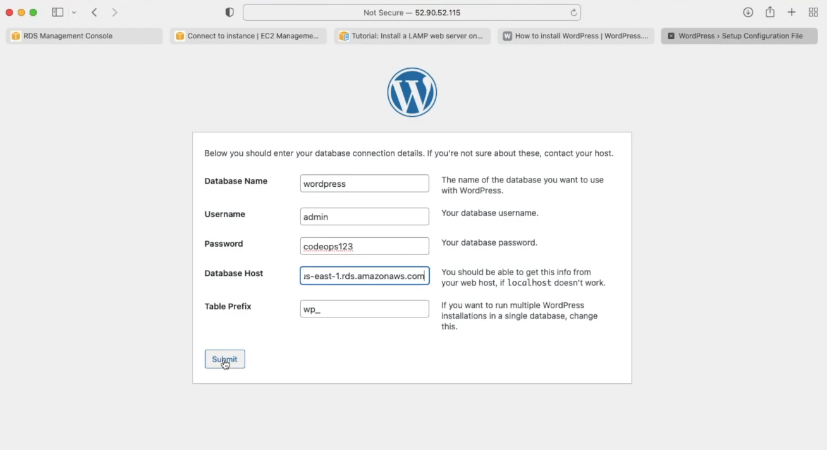
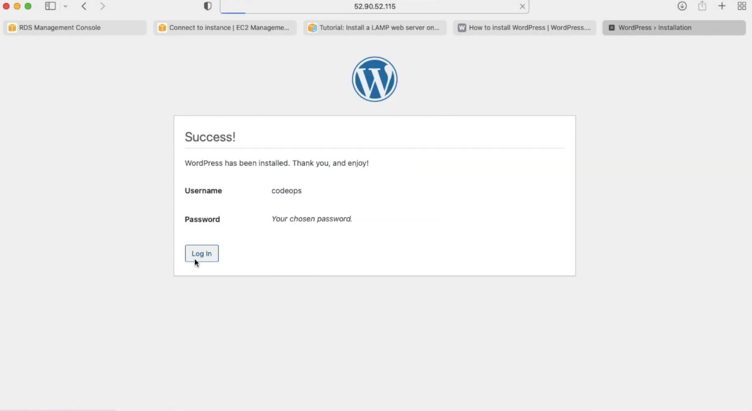

Slide 18
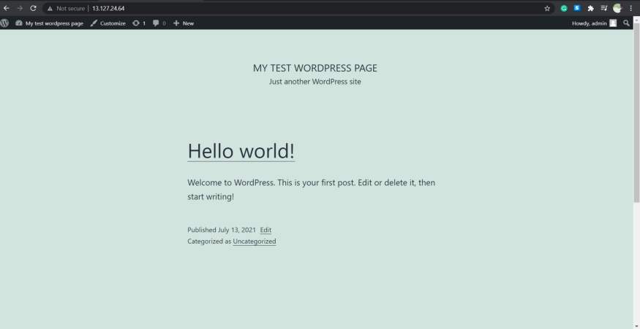

Slide 19
Results and Discussion
First we are creating the requirements as
database
ec2 machine
downloading of word press and my sql.
we are linking rds with live website with the help of word press.
Benefits of linking rds with website easy scalable , availability and durability , cost effectiveness, security, manageability, security

Slide 20
Conclusion
Amazon rds is a high performance, highly available, and enterprise-grade database built for the cloud. Leveraging Amazon rds can result in better performance and greater availability than other open-source databases and lower costs than most commercial grade databases

Slide 21
References
https://docs.aws.amazon.com/AmazonRDS/latest/UserGuide/custom-creating-sqlserver.html
https://docs.aws.amazon.com/pdfs/AmazonRDS/latest/UserGuide/rds-ug.pdf#MySQL.Concepts.FeatureSupport
https://aws.amazon.com/rds/#
https://docs.aws.amazon.com/codedeploy/latest/userguide/tutorials-wordpress-launch-instance.html

Slide 22
THANK YOU

